Slide 1
Neonatal tetanus
Omondi S. Aluoch

Slide 2
Definition
Tetanus an neurological disease characterized by an acute onset of hypertonia, painful muscular contractions (usually of the muscles of the jaw and neck), and generalized muscle spasms without other apparent medical causes.
Only vaccine preventable disease that is infectious but not contagious

Slide 3
Cause
Clostridium Tetani
An anaerobic bacterium
Grows only in dirty wounds
Gram positive motile bacillus
Found in human and animal feces
Found commonly in areas where soil is cultivated, in warm climates and during summer months

Slide 4
Mode of transmission
Acquired during delivery
After delivery
Through unsterile cord cutting
Poor cord care
Occasionally, unsterile circumcision, traditional operations
Environmental and social factors: Unhygienic custom habits,Unhygienic delivery practices

Slide 5
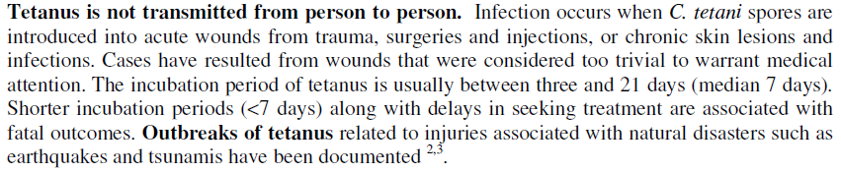
TRANSMISSION :

Slide 6
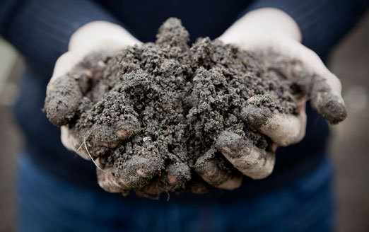
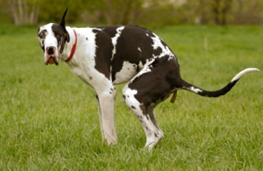
Sources

Slide 7
Pathogenesis
Bacteria gains entry to newborn’s body through umbilical stump cut by an unsterile instrument or treated in an unclean method
Bacteria can only grow in dirty crusted umbilicus
Neurotoxins produced after incubation of 3-10 days
Neurotoxins reach nerves producing typical tetanus spasms

Slide 8
Spores that gain entry can persist in normal tissue for months to years under anaerobic conditions.
When the oxygen levels in the surrounding tissue is sufficiently low, the implanted C. tetani spore then germinates into a new, active vegetative cell that grows and multiplies and most importantly produces tetanus toxin - tetanospasmin and tetanolysin.
Tetanolysin is not believed to be of any significance in the clinical course of tetanus.
Tetanospasmin is a neurotoxin and causes the clinical manifestations of tetanus.

Slide 9
Tetanolysin
Hemolytic toxin
Potentiates infection but does not cause disease process
Tetanospasmin
Binds to NM junction at the site of injury and undergoes retrograde axonal transport to reach presynaptic nerve terminal where it prevents the inhibitory neurotransmitters GLYCINE AND GABA.
In normal states these neurotransmitters prevent release of Ach from excitatory neurons thus prevent muscle contraction.in the presence of toxins these inhibitory impulses are prevented leading to uncontrolled contraction of muscles,

Slide 10
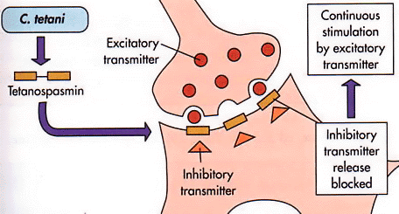

Slide 11
Clinical features
Gradual onset of symptoms- age 3-14 days
Inability to suckle due to spasm of the masseter muscles (trismus)
Increasing rigidity of muscles especially abdominal
Within 36hrs typical tetanus spasms follow
Difficulty in breathing (laryngospasm) with cynosis
Fever and local signs of umbilical infection

Slide 12
Clinical features
The baby develops progressive feeding difficulty
(reflex spasm of massetter makes feeding painful)
(pharyngeal muscles goes into spasm and cause dysphagia chocking)
Spasm of larynx and respiratory muscles are induced by stimuli such as touch ,noise ,bright light, resulting in episodes of apnea and cyanosis.

Slide 13
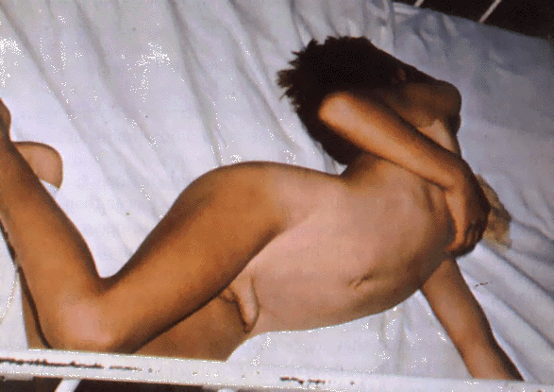
Clinical features
Constipation persists until spasms are relieved,
becomes rigid ,develops paralysis , and may develop opisthotonic posturing(in extension) and experience painful spasm.
Intercurrent infections, dehydration and acidosis complicate the clinical picture:
Opisthotonos in tetanus

Slide 14
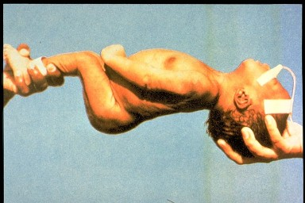
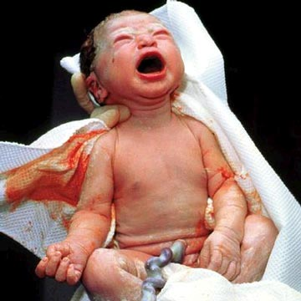

Slide 15
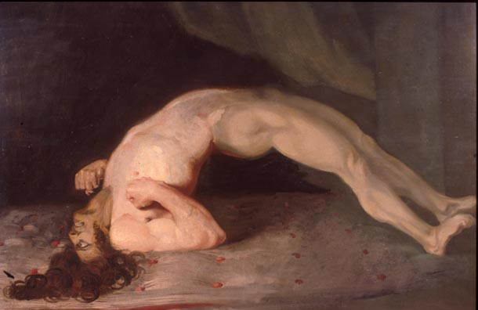

Slide 16
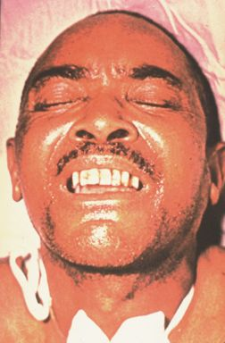
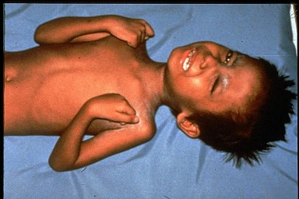
Clinical features
Risus sardonicus

Slide 17
Other symptoms include
:
Drooling
Fever usually absent
Hand or foot spasms
Irritability
Uncontrolled urination or defecation

Slide 18
Sequence of events
Lock Jaw
Stiff Neck
Difficulty Swallowing
Muscle Rigidity
Spasms

Slide 19
Aims of management
Airway maintenance
Prevention of further toxin absorption
Relieving clinical symptoms : spasms, autonomic instability

Slide 20
Management
General measures:
Child nursed in quiet room closely monitored
Avoid bright light, noise and unnecessary handling- these can precipitate spasm
Clean umbilical stump and ensure it is dry

Slide 21
Management
Turn the child 3hrly to prevent pneumonia. Never turn the child to his back due to danger of aspiration
Clear airway of secretion by suction as need arises
Continuously monitor with a special intensive care chart

Slide 22
Intensive care chart for neonatal tetanus
Date ……………… Name………………………………..
Sedation as required |  | 6am | 9am | 12 Noon | 3pm | 6pm | 9pm | 12 mn | 3am
 | Diazepam mgs | 5 | 5 |  | 5 |  | 5 |  | 5
 | Largactil mgs | 12.5 |  | 12.5 |  | 12.5 |  | 12.5
 |  | ATS PPF
 |  | 50 | 50 | 50 | 50 | 50 | 50 | 50 | 50
 |  | abdomen | R | L | Abdomen | R | L | Abdomen | R
 |  | ++++ | +++ | ++ | ++ | + | + | +

Slide 23
Specific treatment
ATS 10,000 U im or iv stat
Newer preparations: human antitetanus immonoglobulin (HTIG) 500 U (still very expensive)
PPF 50,000 U od for 1 week
Notes:
NB/ ATS is only effective against still-circulating tetanus toxins. PPF is only against still-present bacteria

Slide 24
Sedation
Sedate to control spasm but not so much that increase the danger of pneumonia
Begin with diazepam 2.5-5 mg slow iv
Ct with diazepam 2.5-5mg im and largactil 12.5mg 6hrly by NGT

Slide 25
Sedation
Reduce dose once spasm reduce (become less severe)
Pass NGT after primary sedation and give EBM to the baby to meet nutritional needs and keep the breasts active
Assess the infant regularly for frequency and severity of spasm and depth of sedation on basis of respiratory rate and effort

Slide 26
Management
Tracheotomy if resp. is compromised
Artificial respiration

Slide 27
Prognosis
Depends on nursing care and prevention of aspiration of secretions and pneumonia
If incubation is short the prognosis is worse
If the child survives, recovery is complete 2wks to 2 months of onset
Notes:
NB/ survivors DO NOT develop immunity against Tetanus infection. They must be vaccinated with Pentavalent after 1-2months. Therafter with booster dose as in children who have not had tetanus

Slide 28
Prevention
Targets: i) delivery practices
ii) antenatal services
Immunize all children against Tetanus. Give booster to all girls leaving school
All pregnant women not previously vaccinated in ANC 2 inj. Of 0.5ml TT to protect mother and the baby. Total of 5 inj. (doses) offers life protection

Slide 29
Prevention
Encourage hospital delivery
Health education on proper handling of the cord (clean hands,delivery surface, cutting and cleaning ), postnatal visits
Train and equip TBA and MCH workers
Check your own method of handling the cord and equipment processing

Slide 30
Tetanus in older children
Routes of entry:
Wounds or on limbs eg jiggers, injuries, burns, unsterile vaccination or injections
In children without external wound, consider CSOM

Slide 31
Clinical features
Same as in newborn;
Inability to open the mouth
Painful muscle spasms, without loss of consciousness
Spasms involving back muscles result in arching of the back and may rais the child on his heels and neck (opisthotonos)

Slide 32
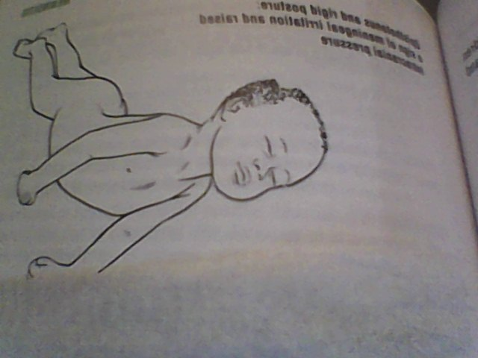
Opisthotonos in tetanus

Slide 33
Treatment
Test dose of ATS first then administer 50,000-100,000U i.m stat. if HTIG is available no test dose is given (no risk of Rxn) give in dose of 30-300U
Tetanus toxoid 0.5mls stat
*PPF 0.1g/kg/day for 1wk

Slide 34
Treatment
NGT and IV line established
Surgical wound cleaning
Sedation- Diazepam 5-10mg and CPZ (individually adjusted) 6hly according to severity of spasm
Afterwards give full vaccination of TT or DPT-HepB+Hib

Slide 35
Tetanus prevention after a wound
Give TT 0.5ml im stat (this is a booster as many children have been immunized in the 1st year of life)
If not sure of primary immunization, give HTIG 250U im, if not available ATS 10,000U im after an intradermal test dose of 0.02ml

Slide 36
Tetanus prevention after a wound
Repeat TT (TT2)after 1month
If wound is contaminated give a course of A/B
Clean the wound

Slide 37
Thank you
The end

